Slide 1
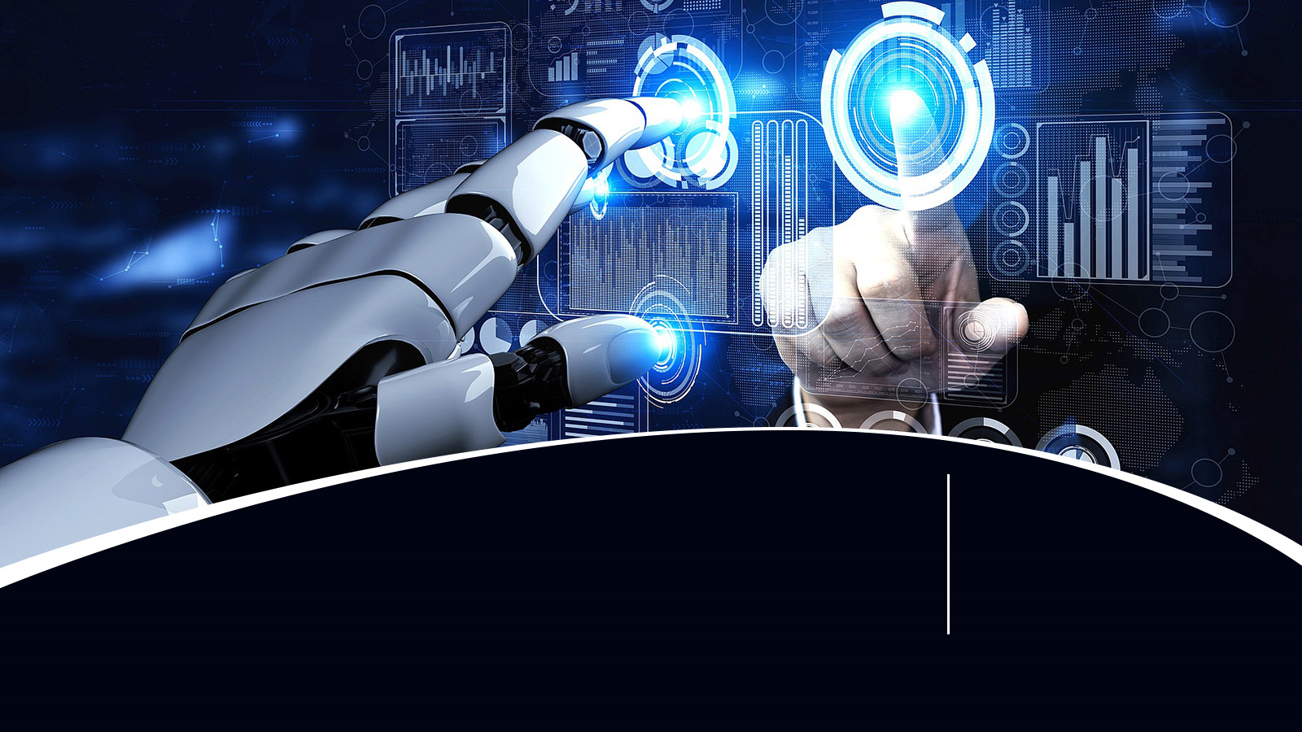

Artificial Intelligence & Data Science Using Python

Slide 2
AI
Artificial Intelligence
ML
Machine Learning
DL
Deep Learning
GAI
Generative Artificial Intelligence

Slide 3
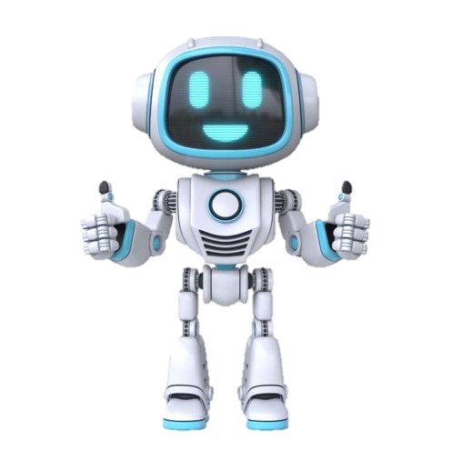
ARTIFICIAL INTELLIGENCE
What is an AI?
AI Application is to do something without human interaction

Slide 4
AI APPLICATIONS
Healthcare:
Diagnosis, personalized medicine.
Finance:
Fraud detection, algorithmic trading.
Automotive:
Autonomous vehicles.
Technology:
Natural language processing, virtual assistants.
Industry:
Robotics, process automation.

Slide 5

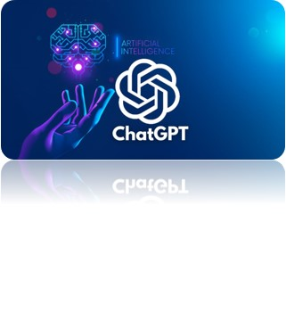

AI Applications

Slide 6
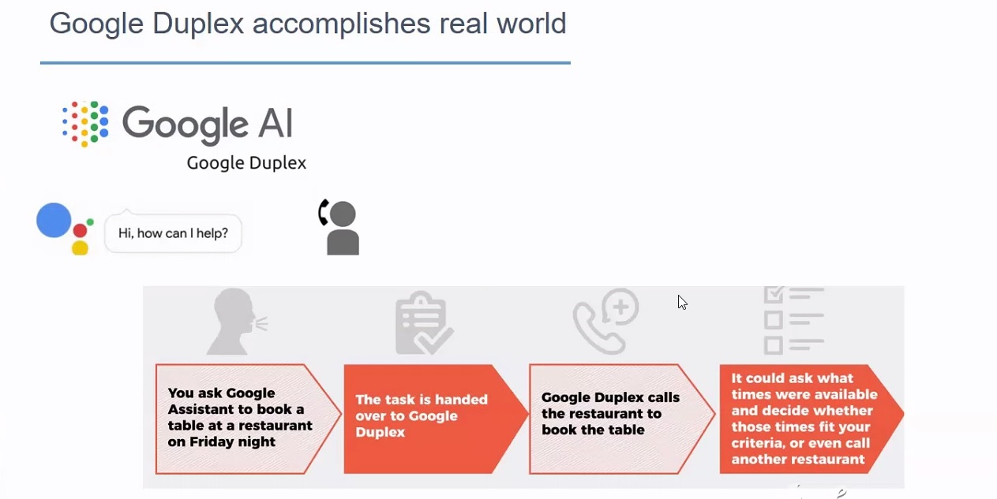

Slide 7
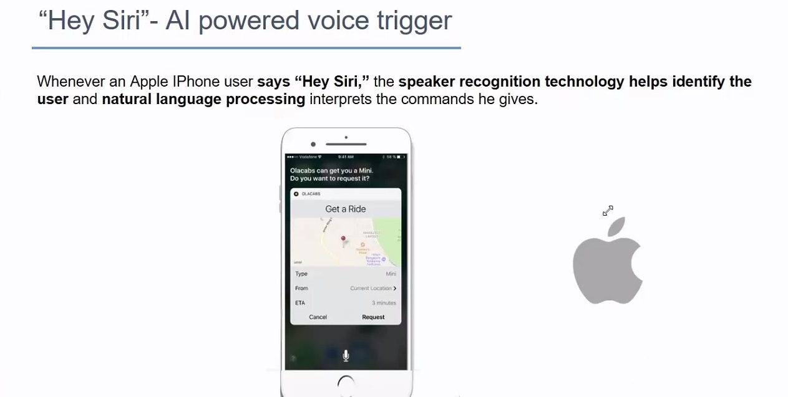

Slide 8
TYPES OF AI
Narrow AI (Weak AI):
Designed for a specific task (e.g., voice assistants).
General AI (Strong AI):
Capable of understanding, learning, and applying knowledge across various tasks (still a theoretical concept).

Slide 9
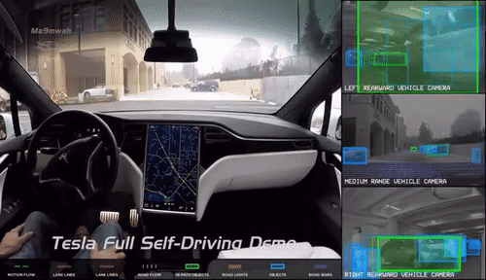
Comma. Ai's approach to AI for self driving cars is based on agent that learns to clone behaviors and plans maneuvers by simulating the future events in the road
9

Slide 10
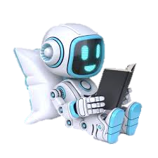
MACHINE LEARNING
What is ML?
AI
Machine Learning is a subset of AI that enables systems to learn and improve from experience without explicit programming.
ML

Slide 11
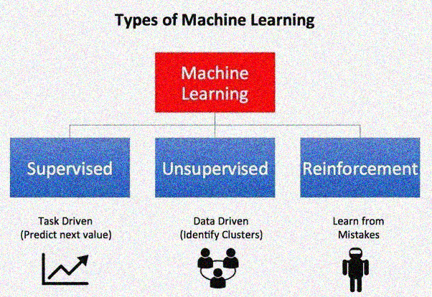

Slide 12
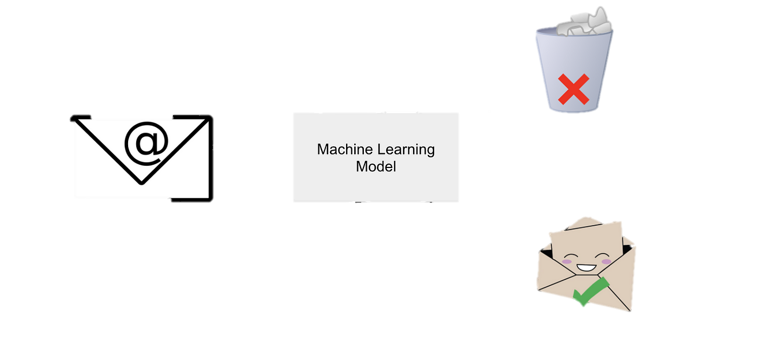
SUPERVISED ML
Supervised learning is a type of machine learning where the algorithm is trained on a labeled dataset, meaning that the input data is paired with the corresponding correct output
SPAM
NOT SPAM

Slide 13
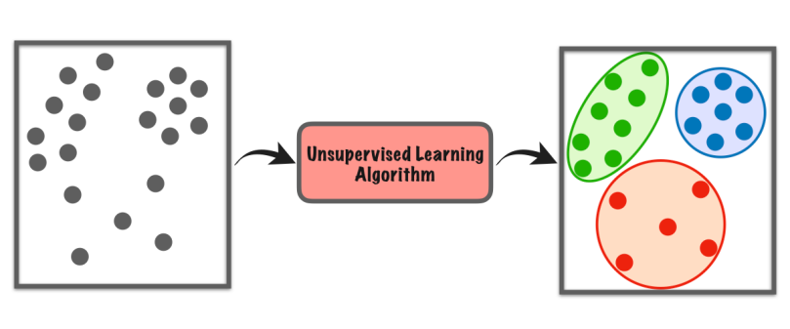
UNSUPERVISED ML
Unsupervised learning is a type of machine learning where the algorithm is given data without explicit instructions on what to do with it.

Slide 14
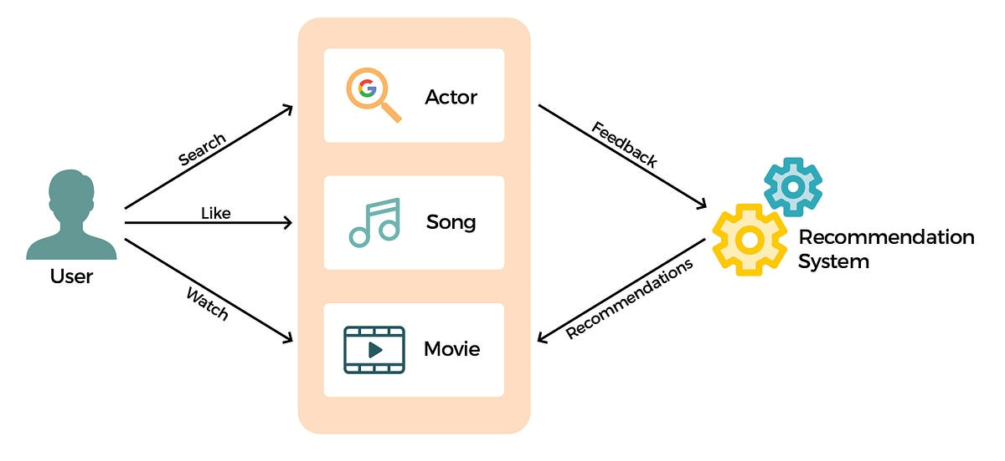
REINFORCEMENT ML
Reinforcement learning is a type of machine learning where an agent learns to make decisions by interacting with an environment

Slide 15
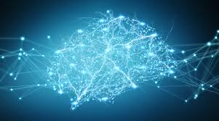
DEEP LEARNING
It is a subset of machine learning or It is inspired by the structure and function of the human brain, specifically neural networks. There are different types of network in Deep Learning. We can solve complex cases with deep learning.

Slide 16
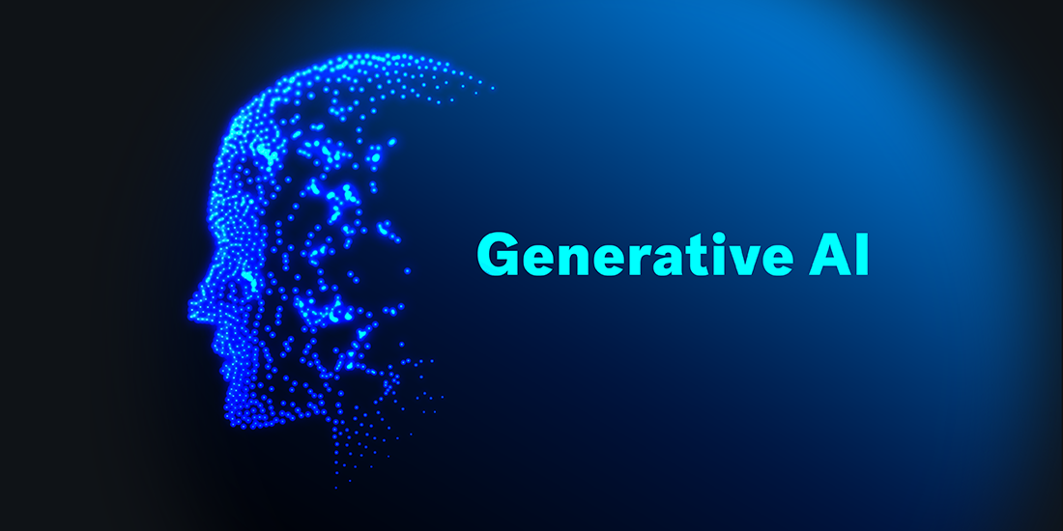
GENERATIVE AI
Generative AI refers to a category of artificial intelligence systems designed to generate new content, data, or information that is not explicitly programmed but is instead created by the model itself.

Slide 17
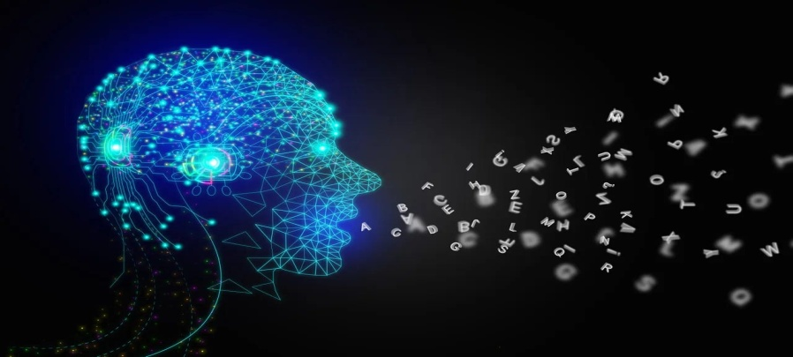
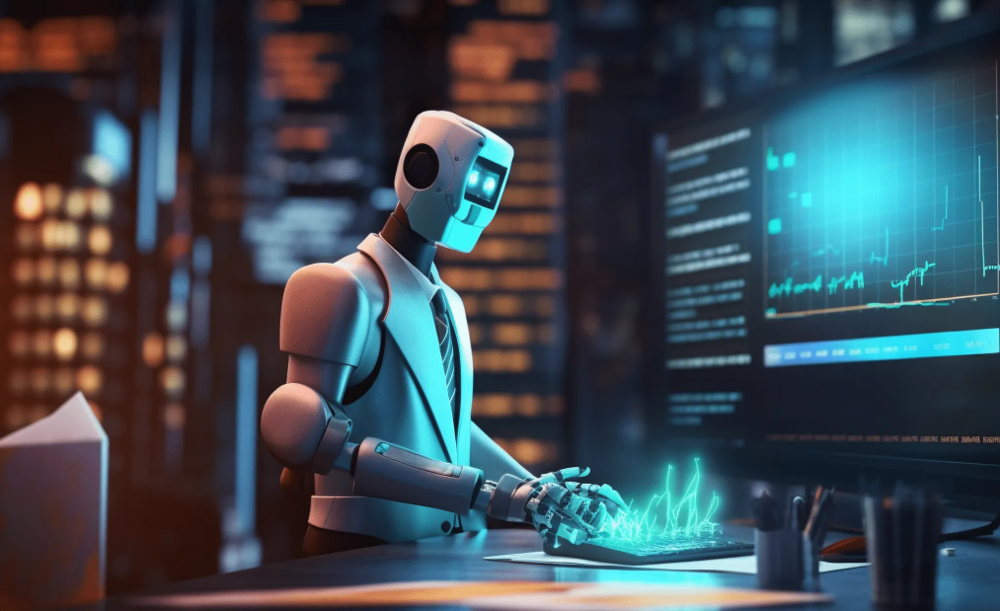
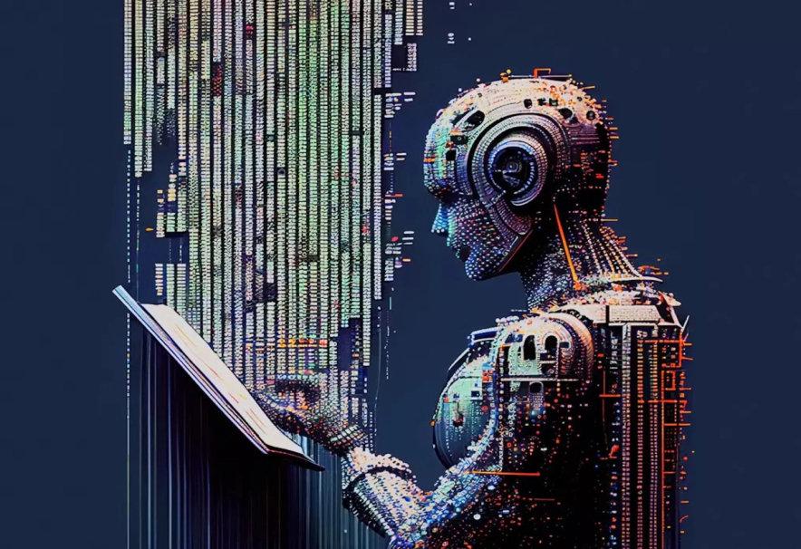
GAI APPLICATIONS

Slide 18
DATA SCIENCE
AI
Artificial Intelligence
Data Science
ML
Machine Learning
DL
Deep Learning
Mathematical Tools
Generative Artificial Intelligence
GAI

Slide 19
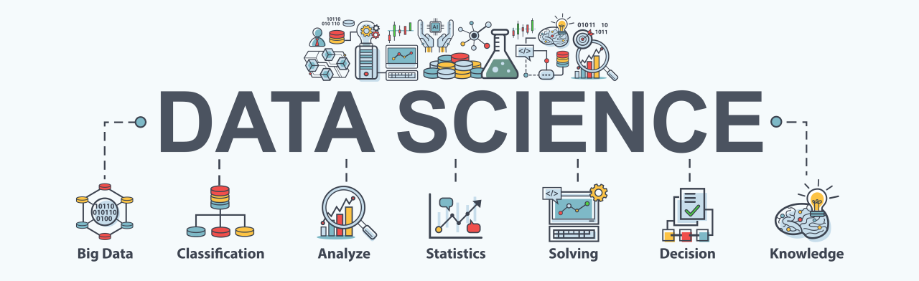
DATA SCIENCE
Data science is a multidisciplinary field that uses scientific methods, processes, algorithms, and systems to extract insights and knowledge from structured and unstructured data

Slide 20
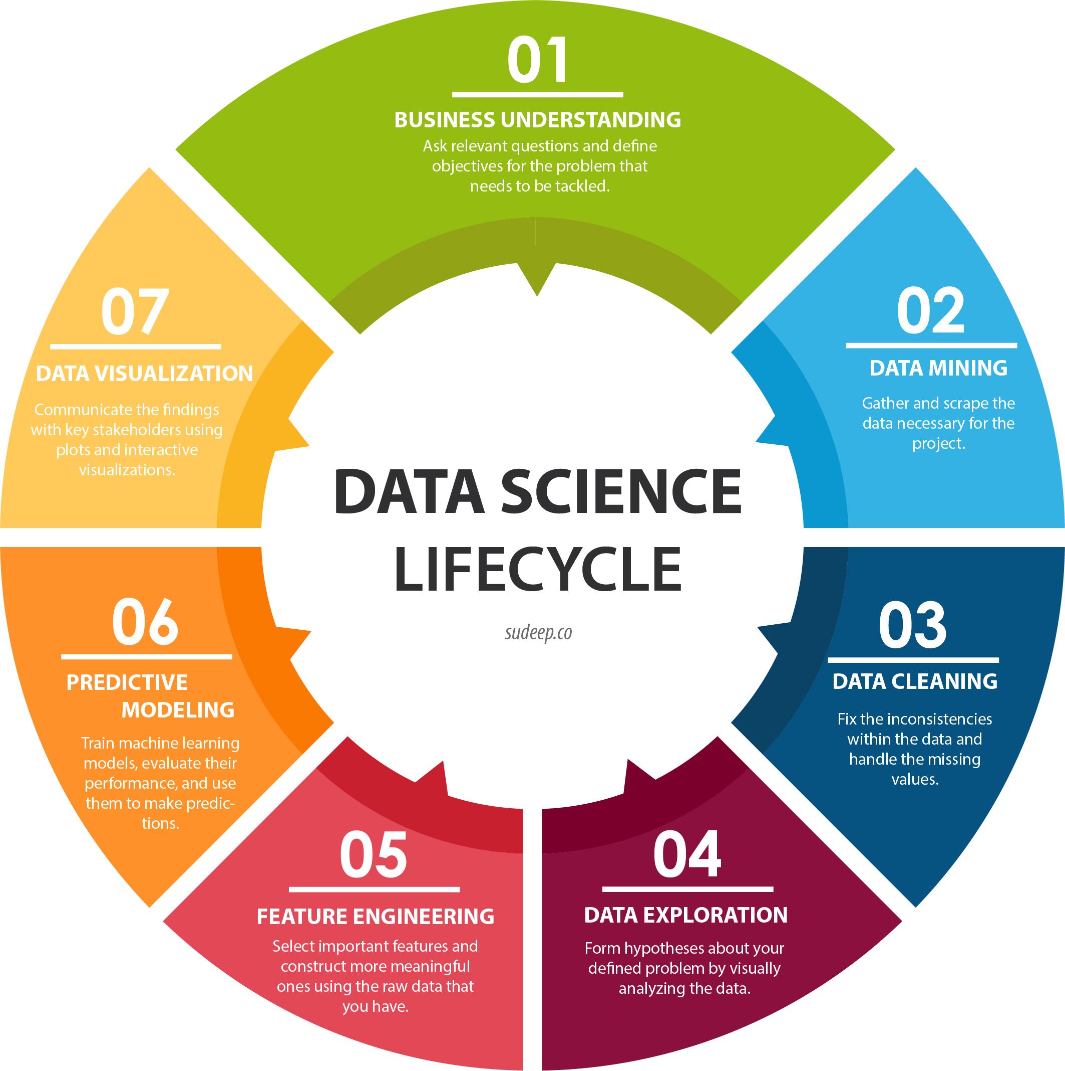

Slide 21
JOB PROFILE
Software Engineer
Python Developer
Research Analyst
Data Analyst
Data Scientist
Software Developer
Senior Software Engineer
Python Senior Developer
Machine Learning Engineer
AI Researcher
Robotics Engineer
Business intelligence Engineer

Slide 22
ThinkNEXT Technologies Private Limited
SCF 113, Sector 65, Mohali (Chandigarh)
Contact: 7837401000, 7837402000 www.thinknexttraining.com

